Slide 1
Hello Everyone
You know the deal by now, it involves sitting down.

Slide 2
It’s the holiday season!
Let’s celebrate that fact ☺

Slide 3
What is the deal?
Pick a holiday from the list
Do research on that holiday
Write a (short) report
Present to the class (in the week before the Christmas break)
Add the report and PP to your portfolio.

Slide 4
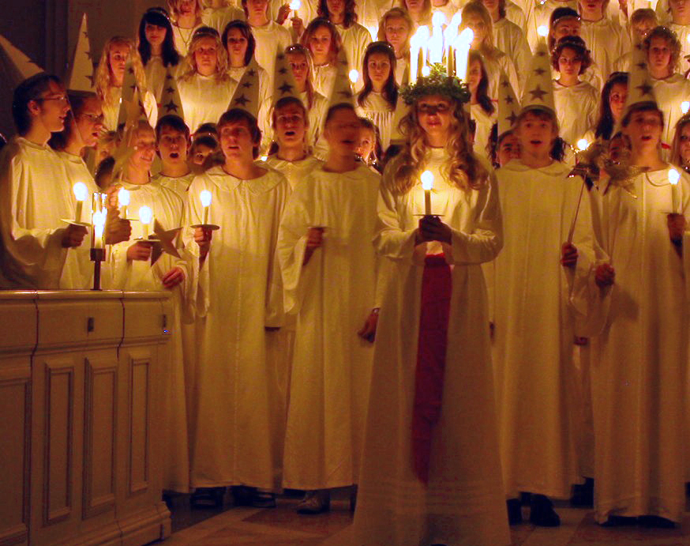
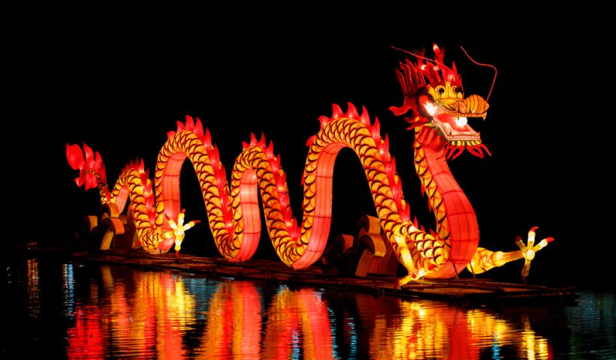
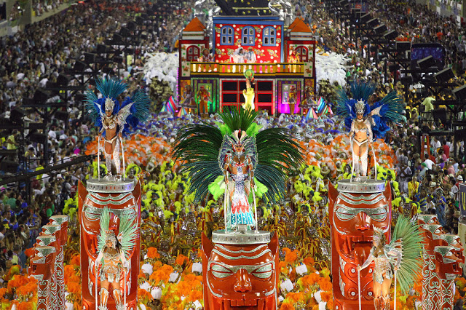
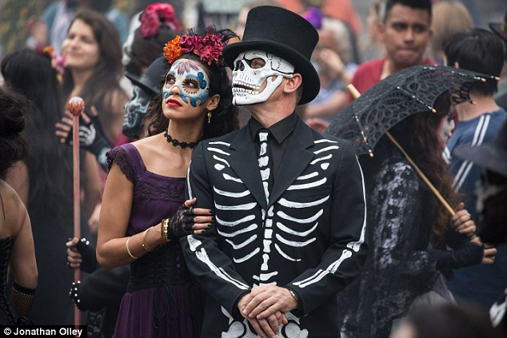
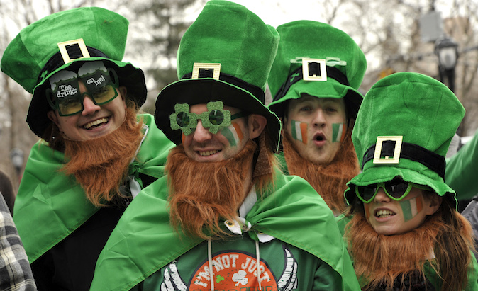
What are the options?
Day of the Dead (Dias de Los Muertos)
Rosh Hashanah (Jewish New Year)
Saint Lucy’s day
Chinese New Year
St Patrick’s Day
Carnival

Slide 5
What you HAVE TO research:
What is the actual holiday?
Its origins
What do people do on that day?
What do people eat on that day?
Are there any other customs on that day?
Would you like to celebrate this holiday?

